Slide 1
Ionosphere and multipath effects in multi-band multi-gnss timing
Nov 8, 2018
Paula Syrjärinne

Slide 2
U-blox timing & positioning receivers
From GPS single frequency to multi-GNSS multi-frequency
GPS L1 C/A
GPS L1 C/A
GPS L2C
GLO L1OF
GLO L1OF
GLO L2OF
GPS L1 C/A
BDS B1
GAL E1
GAL E5b
GAL E1
BDS B1
BDS B2
Multi-GNSS
Single band
Legacy signals
=>
More measurements, More accuracy,
More availability
Single GNSS
Single band
Legacy signals
Multi-GNSS
Multi-band
Modernized signals
=>
More accurate navigation data
Dual-frequency navigation

Slide 3
Targets & Challenges
Operating environment
Urban
Stand-alone
Multi-frequency
Targets
High precision: 5ns std (24h)
High stability: 15ns peak-to-peak
Customer requirements
Challenges
No external corrections
Multipath
Verification

Slide 4
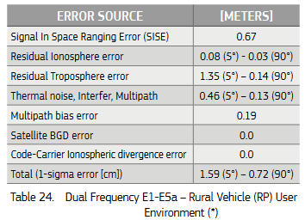
Error budget*
How much does each of the error sources affect the accuracy
Residual ionosphere delay error and multipath play a major role
We propose means to correct the ionosphere error and to identify multipath-affected measurements by using multi-frequency measurements
* From https://www.gsc-europa.eu/system/files/galileo_documents/Galileo-OS-SDD.pdf

Slide 5
Ionospheric delays
Ionosphere causes frequency-dependent delay to the GNSS signal
This delay is considered the largest error source in open-sky environments
Ionosphere delay depends heavily on
Time of day
Time of year
Solar activity
Latitude
If the used ionosphere model does not fit the true delay perfectly throughout the day, we often see a diurnal error pattern

Slide 6
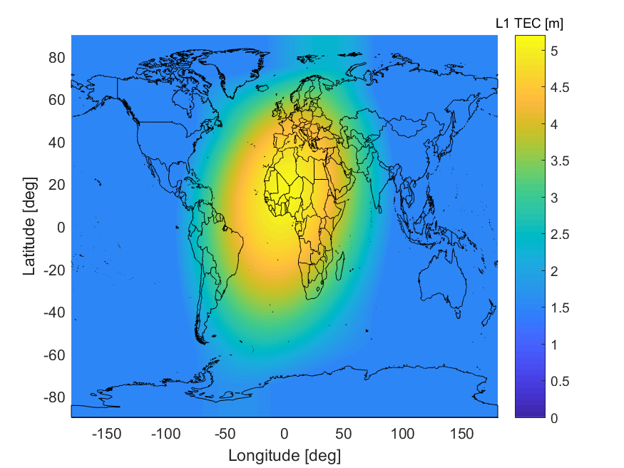
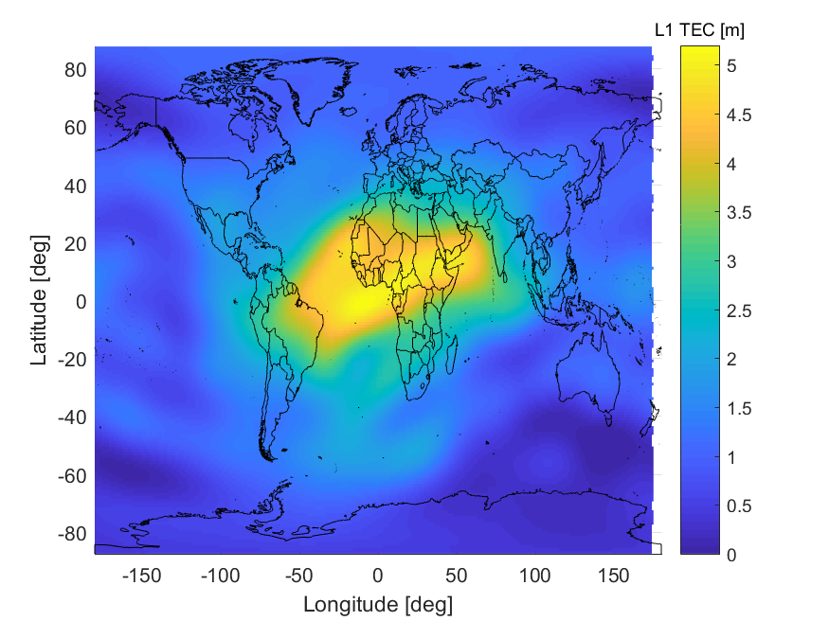
Ionospheric delay compensation
Option 1. Broadcast model
GPS broadcast model
GPS broadcast navigation message contains parameters for Klobuchar ionosphere model
Similarly for Beidou
The model is global and usually does not have an accurate fit
Especially high latitudes suffer from poor model fit
IGS model

Slide 7
Ionospheric delay compensation
Option 2. SBAS
Geostationary SBAS satellites provide ionosphere correction grid
This service is free of charge and available for standalone receivers in the coverage area (provided they have visibility towards equator)
The ionosphere correction is accurate
At least according to experience with EGNOS
The drawback is the poor availability of SBAS outside Europe and North America
There are future plans to widen the coverage in Asia, Africa and Australia

Slide 8
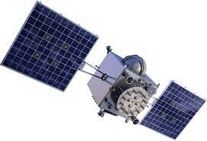
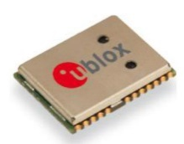
Ionospheric delay compensation
Option 3. External corrections
In some cases, the ionospheric delays can be fed to the receiver as external corrections e.g. via internet connection
Depending on the correction source, these can be very accurate and enable high-precisions mode
Not available for stand-alone receivers!
Satellite signals
External corrections, e.g. from
another receiver
service provider

Slide 9
Ionospheric delay compensation
Option 4. Estimation from dual-frequency measurements
If we receive two signals from the same satellite, we can estimate the delay from geometry-free combination of pseudoranges
Carrier smoothing the estimate further improves the ionosphere delay estimate accuracy
Challenges:
Lower number of dual-frequency measurements => poorer measurement geometry
Multipath affects the two signals differently and causes errors to the geometry free combination
When multipath and low number of measurements occur at the same time, instability in the accuracy can be noticed
Fortunately, multipath can usually be identified and the number of dual-frequency broadcasting satellites is growing continuously

Slide 10
Time series comparison
The noisy raw code differences (geometry-free observations) can be smoothed using carrier range differences
High code difference amplitude usually indicates multipath problems
Iono delay estimate computed from code measurements
Smoothed iono delay estimate
SBAS ionosphere delay correction
Klobuchar ionosphere delay correction

Slide 11
Geometry-free measurement oscillation
Repeating pattern
For static receivers, the geometry-free measurement oscillation is strictly dependent on the signal angle of arrival
The same pattern repeats when the satellite crosses the same trajectory on the sky

Slide 12
Static antenna multipath environment
Rooftop antenna (open sky)
We can learn static antenna environment from the geometry-free measurement oscillation pattern
You can see the areas that are prone to multipath from the oscillation amplitude

Slide 13
Static antenna multipath environment
Restricted view
In this experiment, the antenna was placed on an office window, allowing visibility to only one direction.
The oscillation amplitude clearly shows the line-of-sight visibility area of the antenna.

Slide 14
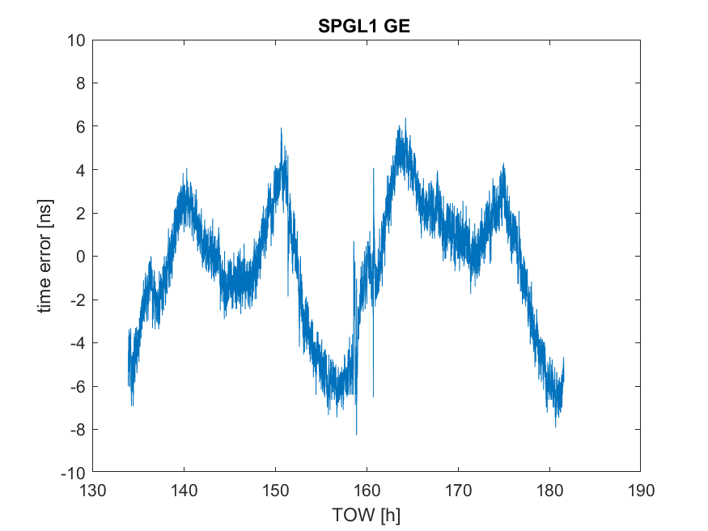
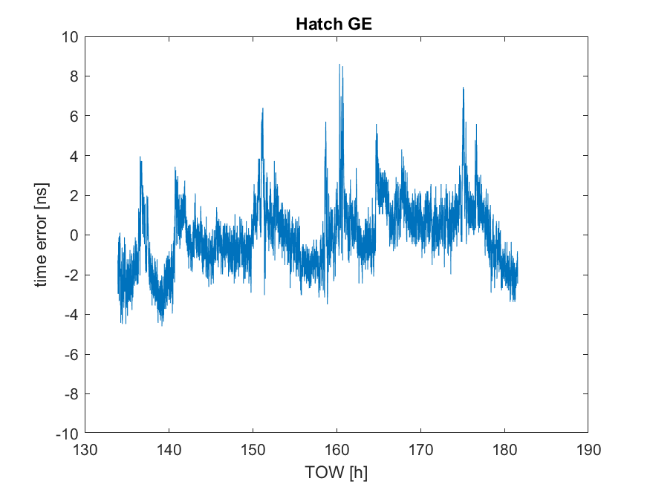
Single vs dual frequency performance 48h
GPS L1C/A + L2C & Galileo E1 + E5b
L1 with Klobuchar ionosphere correction
Smoothed dual-frequency ionosphere estimation
STD 3.4ns
Peak-to-peak 14.7ns
STD 1.6ns
Peak-to-peak 13.2ns

Slide 15
References
Basile, F., Moore, T., Hill, C., McGraw, G., Johnson, A.: Multi-frequency precise point positioning using GPS and Galileo data with smoothed ionospheric corrections, 2018 IEEE/ION Position, Location and Navigation Symposium (PLANS)
Pirsiavash, A., Broumandan, A., Lachapelle, G., O’Keefe, K.: GNSS Code Multipath Mitigation by Cascading Measurement Monitoring Techniques, Sensors 2018, 18, 1967
Bolla, P., Lohan, E.: Dual-frequency signal processing architecture for robust and precise positioning applications, 2018 IEEE/ION Position, Location and Navigation Symposium (PLANS)
Carrano, C., Groves, K.: Ionospheric Data Processing and Analysis, Workshop on Satellite Navigation Science and Technology for Africa, March 2009, https://www2.bc.edu/charles-carrano/carrano-trieste-2009.pdf
Julien, O., Macabiau, C., Issler, J-L.: Ionospheric Delay Estimation Strategies Using Galileo E5 Signals Only, 22nd International Meeting of the Satellite Division of The Institute of Navigation, Savannah, GA, September 2009
Julien, O., Issler, J-L., Lestarquit, L.: Estimating the Ionospheric Delay Using GPS/Galileo Signals in the E5 Band, EWGNSS 2013
Marel, H., Bakker, P.: GNSS Solutions: Single- versus Dual Frequency Precise Point Positioning, InsideGNSS July/August 2012
Mitch, R., Psiaki, M.: Local Ionosphere Model Estimation From Dual-Frequency GNSS Observables, ION GNSS 2010
Sunehra, D.: Real-Time Estimation of Ionospheric Delay Using Dual Frequency GPS Observations, European Scientific Journal, May 2013 edition vol. 9, No. 15
Sunehra, D.: TEC and Instrumental Bias Estimation of GAGAN Station Using Kalman Filter and SCORE Algorithm, Positioning, 7, 2016

